Slide 1
Teaching so that ALL students can Learn: Universal Design for Learning INFD 2019 Wed., July 31, 4-4:45 pm
Jane Harris
jdharri5@uncg.edu
Deandra Little
dlittle@elon.edu
Notes:
Wednesday 4:00pm-4:45pm Alexander
Teaching so that ALL Students Can Learn: UDL
In this interactive session, we will introduce and discuss the rationale and principles for Universal Design for Learning (UDL), an approach to designing learning environments to make them accessible to a diverse set of learners (and teachers).
Outline:
4:00-4:07 (7 min) Introduction, Overview & Definitions: slides 2-5, including video
4:08-4:15 (7 min) Jane set up: Slide 5-6
4:15-4:35 (20 min) UDL principles + activity (10 + 10): Slide 7-9
4:35-4:45 (8-10 mins) Addressing UDL as a faculty developer and wrap up: Slide 10

Slide 2
Overview
Defining terms
Understanding UDL Principles
Addressing UDL & Accessibility as a Developer
Practical
Conversational
Research-informed
Model effective UDL practice
Notes:
4:00-4:07 (7 min) Introduction, Overview & Definitions (slides 2-4, including video)
Goals, Topics covered
Note-taking: Google doc for note-taking (in a class, recruit volunteers, discuss how to add in questions that the group/individuals can answer)
We will trade off taking notes on Google doc
briefly explain our choices, to make them transparent)

Slide 3
Notes:
Show a clip McGill video: Universal Design 0:50-2:04
https://www.youtube.com/watch?v=LjUKGBipJZA&feature=youtu.be&t=50
<iframe width="560" height="315" src="https://www.youtube.com/watch?v=LjUKGBipJZA&feature=youtu.be&t=50" frameborder="0" allow="accelerometer; autoplay; encrypted-media; gyroscope; picture-in-picture" allowfullscreen></iframe>

Slide 4
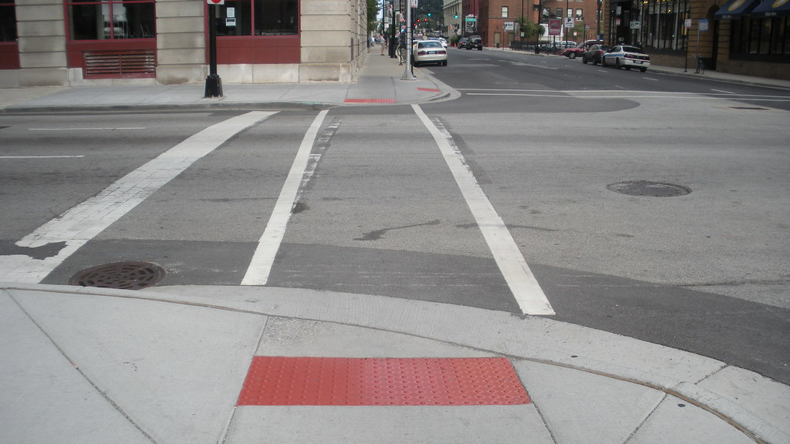
“Universal design focuses on eliminating barriers through initial designs that consider the needs of diverse people, rather than overcoming barriers later through individual adaptation. Because the intended users are whole communities, universally designed environments are engineered for flexibility and designed to anticipate the need for alternatives, options, and adaptations to meet the challenge of diversity.”
D. Rose et al., 2006
Notes:
UDL=educational framework based on research in the learning sciences, including cognitive neuroscience, that guides the development of flexible learning environments that can accommodate individual learning differences
Inclusive education is “an educational philosophy and practice that aims to improve learning and active participation of all students in a common educational context.” (Moriña, 2017)

Slide 5
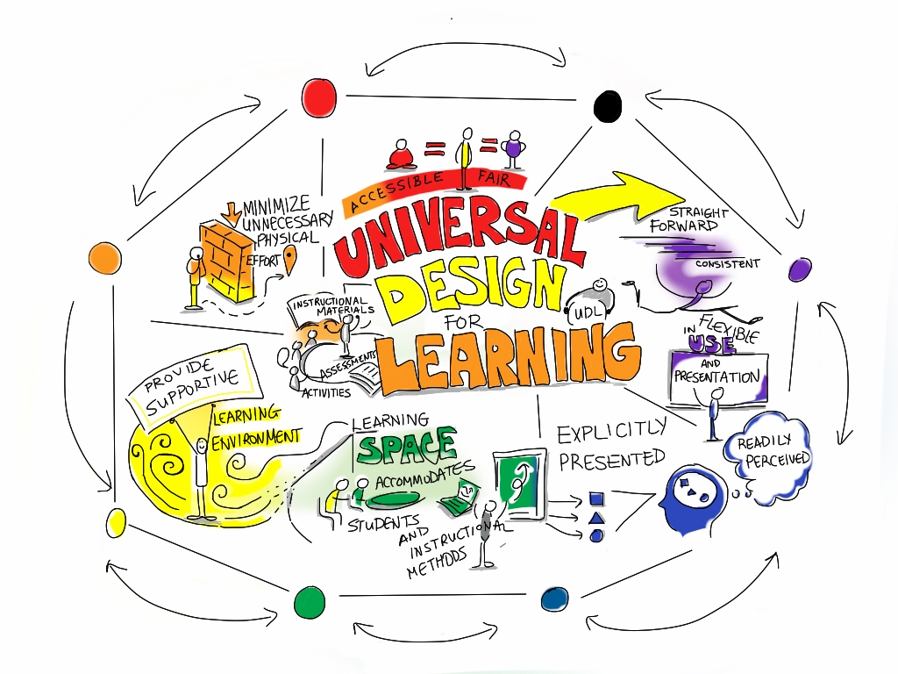
Why is Universal Design for Learning (UDL) important?
A pedagogical issue
An accessibility issue
A social justice and equity issue:
UDL strategies support inclusive education; not only do they help a targeted group, but also help all students learn and succeed.
Image: Giulia Forsythe
Notes:
1-2 min
Broad framing – UD for L as
A pedagogical issue – based on evidence-based teaching and learning strategies, research from learning sciences…
a social justice/equity issue – connected to Inclusive education;
Just thing to do; we are from a variety of institutions, with diversity along many dimensions – how to provide an equitable experience for students
An accessibility issue -- Addressing problems with the learning environment that can help all students learn, rather than individual problems that only address one student’s needs.
Emphasizes an asset-based approach instead of deficit-based
Benefits individual and community
Image: Giulia Forsythe : https://www.flickr.com/photos/gforsythe/8527950743

Slide 6
Activity
Recall an experience in which the learning opportunity was either:
inequitable, inaccessible, or not successfully providing opportunities for a range of learners OR
accessible, successfully providing opportunity for a diverse population to learn. (1 min)
Pair up and introduce yourselves to one another. (1 min)
Take 2 + 2 minutes to briefly share your experience. Consider together what characteristics made it fit into either category. (4 min; we’ll prompt you to switch.)
Notes:
4:08-4:15 (7 min) Jane
If UDL is based on equity of access, implied is unequal and/or diversity.
-Diversity is multidimensional, yes? What kinds of diversity have you encountered? (gender, sexual orientation, ethnic group, race, culture, socio-economic, neurotypical/atypical, physical or cognitive differences, life experiences, life constraints)
Activity
Take 1 minute to recall an experience in which either a) the learning opportunity was inequitable or inaccessible OR b) that successfully provided opportunity for a diverse population to learn.
Take 1 minute to pair up and introduce yourselves to one another.
Take 2 + 2 minutes to briefly share your experience. I will prompt you to switch at the 2-min mark.
1 min debrief – Let’s hear from two people – one who heard or experienced a challenge and one who heard or experienced a success.

Slide 7
Principles of UDL: Provide Multiple Means of …
Engagement
Use multiple methods of motivating learners
Representation
Provide content or materials in multiple formats
Action and Expression
Give learners multiple ways to show what they know
(Rose & Myer, 1984; Kelly, 2014)
Notes:
4:15-4:35 UDL principles + activity (10 + 10)
10 min to set-up and go into a little more detail with examples in next slides; Jane & Deandra divide up and take turns explaining & giving examples of each principle
“UDL helps address learner variability by suggesting flexible goals, methods, materials, and assessments that empower educators to meet these varied needs.”
-instructors should (a) provide content or materials in multiple formats, (b) give learners multiple ways to show what they know, and (c) use multiple methods of motivating learners.
http://www.udlcenter.org/aboutudl/whatisudl/3principles
Kelly, K (2014) Fostering Inclusion with UDL, https://www.aacu.org/diversitydemocracy/2014/fall/kelly

Slide 8
Notes:
*A little more explanation and Examples
Engagement/Why?
Explanation: “Some students are highly engaged by spontaneity and novelty (e.g., students with ADD/ADHD), but others are disengaged or even frightened by those aspects in a learning environment (e.g., students with Asperger’s Syndrome or autism). Similarly, some students are engaged by risk and challenge in a learning environment, while others seek safety and support. Some are attracted to dynamic social forms of learning, and others shy away and recede from social forms.” (Rose, et al 2006, 4)
Examples: TILT – purpose/task; real-life scenarios
Representation/What?
the content is explicitly viewed from the multiple perspectives and varied experiences of a range of groups. Be sensitive to cues (avoid stereotypical ones) Cues include official statements and language but also have implications for the classroom, including social organization, music, images, etc.
Action & Expression:
Example: collaborative learning
Transparency about expectations and norms benefits all students’ learning and is especially beneficial for first-generation college students and other groups who have been traditionally underserved by higher education (Eddy & Hogan, 2014; Stephens et al., 2012). Transparent practices include identifying learning objectives for class activities, explaining how students should communicate with you and make use of opportunities like office hours, and making clear how student work will be assessed in every dimension of the course, including participation.

Slide 9
Multiple Means of Engagement (Why?)
Use multiple methods of motivating learners
Multiple Means of Action and Expression (How?)
Give learners multiple ways to show what they know
Multiple Means of Representation (What?)
Provide content in multiple formats and represent multiple perspectives or experiences.
Chose a note-taker for your group. Then discuss the following questions for your principle:
What exemplars from your campus could share with colleagues in a consultation or workshop? How are colleagues already doing this?
2) How can you put this principle into action as a developer (in programming, online …)?
3) What are the areas of greatest need or challenge related to this principle on your campus? For faculty? For students? For collaborators? For the institution?
Notes:
4:25-4:35 (10 min) Activity in Google doc – community sharing – take notes of discussion, add resource, etc.
Short debrief (1-2 min) – we note a couple of take-aways based on our observations of Google doc notes or what we’ve heard from the groups’ discussion

Slide 10
Points to consider: http://bit.ly/2S6znKg
Resources and further reading: http://bit.ly/2YNWKv0
Addressing UDL and Accessibility as a Developer
Notes:
4:35-4:45 (10 min) to discuss & wrap up
Handouts:
Resources – practical tips
References
Q&A: We would be glad to entertain questions, but please do not feel obligated to stay, as we are at the end of the session time.

Slide 11
Teaching so that ALL students can Learn: Universal Design for Learning INFD 2019 Wed., July 31, 4-4:45 pm
Jane Harris
jdharri5@uncg.edu
Deandra Little
dlittle@elon.edu
Notes:
Wednesday 4:00pm-4:45pm Alexander
Teaching so that ALL Students Can Learn: UDL
In this interactive session, we will introduce and discuss the rationale and principles for Universal Design for Learning (UDL), an approach to designing learning environments to make them accessible to a diverse set of learners (and teachers).
Outline:
4:00-4:07 (7 min) Introduction, Overview & Definitions: slides 2-5, including video
4:08-4:15 (7 min) Jane set up: Slide 5-6
4:15-4:35 (20 min) UDL principles + activity (10 + 10): Slide 7-9
4:35-4:45 (8-10 mins) Addressing UDL as a faculty developer and wrap up: Slide 10

Slide 12
Application: Taking an assets-based approach to assumptions Reflect on a common teaching/learning situation for you, using the following questions as a guide: -How does taking an assets-based approach to your assumptions change your understanding of this situation? -What’s possible in this situation with different assumptions? After individual reflection, talk with a neighbor about your situation and your assumptions.
Notes:
DL: Questioning your assumptions – practicing an assets-based approach
Our examples
DL: example about students who needed accommodations in a writing-intensive class
PF: teaching adult students who were sleeping in class – often they were coming in after their work day and before they went home; empathy and awareness about what I attribute student behaviors to
Write/Talk in pairs –
Practice: Take an assets-based approach
Think about a common teaching/learning situation.
What’s possible if you take an assets-based approach to your assumptions in this experience?
How might that be different? For you or for students?
What assumptions might you have/might you have differently?
What happens if you re-frame your assumptions?
Be aware of unconscious biases that we all may have. Understand that these biases may affect the way we behave towards, and evaluate, students. Although we are not consciously aware of having these attitudes, it doesn’t mean that we cannot control our behavior or think of ways to reduce the influence of these unconscious tendencies. Awareness is the first step.

