Slide 1
The Learner-Centered Classroom
Ben Peterson, Ph.D.
Teaching Innovations Office, UTLC
bcpeters@uncg.edu

Slide 2
Learner-Centered Design
From HCI through Self-Determination Theory
Dimensions of Reframing the Classroom
Design Strategies
Scaffolding
Options, Diversity, and Choice in Assessment
Planned Flexibility and Adaptability
Baby Steps and the Benefits of Incrementality

Slide 3
First, what is the alternative?
Instructor-centered?
Content-centered?
Credential-centered?

Slide 4
First, what is the alternative?
Instructor-centered?
“sage v. guide” debate
Content-centered?
material v. skills
Credential-centered?
fixed v. growth

Slide 5
Origins in Human-Computer Interaction
Soloway et al, 1994
Advocated a transition away from “usability” to a focus on “understanding”
McCombs and Whisler, 1997
“The perspective that focuses on individual learners (their heredity, experiences, perspectives, backgrounds, talents, interests, capacities, and needs) with a focus on learning”

Slide 6
Adaptive Learning
“Imagine that you could give every learner their own personalized course, made specifically for their strengths, weaknesses, goals, and engagement patterns” (McGraw Hill Education)

Slide 7
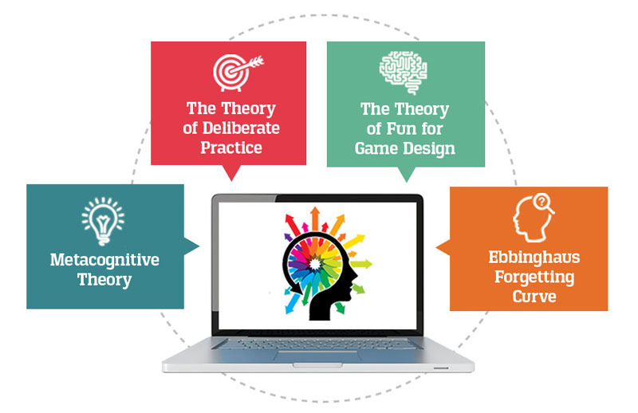
Adaptive Learning

Slide 8
Self-Determination Theory
A theory of learning based in intrinsic motivation
Competence
Autonomy
Relatedness

Slide 9
Dimensions of Reframing in the Learner-Centered Classroom
Function of Content
Role of the Instructor
Responsibility for Learning
Purpose and Process of Assessment
Balance of Power
(Blumberg, Developing Learner-Centered Teaching)

Slide 10
Dimensions of Reframing in the Learner-Centered Classroom
Content
Instructor
Student
Student

Slide 11
Dimensions of Reframing in the Learner-Centered Classroom
Instructor
Student
Student
Content

Slide 12
Function of Content
From Memorization to Application and Reflection

Slide 13
Role of the Instructor
Matching Instruction with Learning Outcomes
From Access to Assistance

Slide 14
Responsibility for Learning
Emphasis on Learning Process
Recognition of Challenge
Responsibility Shifts to Learners

Slide 15
Purpose and Process of Assessment
From Exclusively Summative to Consistently Formative
From Assigning to Developing

Slide 16
Balance of Power
From Mandated and Rigid to Responsive and Flexible
Consistency and Generalizability vs. Forgiving and Attentive

Slide 17
Message and Structure
Learning Outcomes
Design Decisions
Communication and Messaging

Slide 18
Design Strategies
Scaffolding
Diversity/Choice/Options in Assessment
Planned Flexibility and Adaptability

Slide 19
Scaffolding
Zone of Proximal Development
Perception of High Stakes
Demotivational effects of “falling behind” and the loop of the grade-focused mentality

Slide 20
Scaffolding
Is there an assignment in your course for which you feel like some students tend to stumble at the starting line?
How could you break that assignment down so that those problems could be identified earlier?

Slide 21
Anatomy of an Assignment/Course
Brief description
Learning Outcomes
Prerequisite Skills
Preferred Assessment
Signs of Difficulty
Importance of Mastery
Alternate Strategies for Instruction

Slide 22
Options, Diversity, and Choice in Assessment
The Debate over Learning Styles
Matching Assessment to Learning Outcomes
Choice, Autonomy, and Motivation

Slide 23
Options, Diversity, and Choice in Assessment
Is there an assessment that you use currently in which that learning objective could be assessed in other ways?
What might those ways be?
If not, how might you introduce a sense of control into the demonstration of learning?

Slide 24
Planned Flexibility
“No battle plan ever survives first contact with the enemy.”
Expectations about Pace of Learning
Assessment and Adjustment

Slide 25
Planned Flexibility
Built-in unit review for catch-up
Aspirational advanced learning goals
Rewards for evidence of “catch-up” choices

Slide 26
Baby Steps
Think about beginning to use these design principles at the assignment level
You may not employ all of the design strategies, but you’ll grow more comfortable with structuring student learning in this way
Use the baby steps in structure to begin to increase your messaging about the learner-centered principles that are important to you

Slide 27
The “Learner-Centered” Brand
Instructor-centered?
Content-centered?
Credential-centered?

Slide 28
Thanks!
Ben Peterson, Ph.D.
Teaching Innovations Office, UTLC
bcpeters@uncg.edu

