Slide 1
On-demand and Distance Programming
Ben Peterson, PhD
UNC Greensboro
POD
Institute
for New
Faculty Developers
29 July 2019 - 2 August 2019
Greensboro, North Carolina, USA

Slide 2
Overview
Digital Resources: Attending to Needs, Capabilities, and Goals
Development at a Distance: Virtual Presence and Virtual Programming
3 W’s and an H: Why, What, Who and How
Brainstorming about Resources and Distance Programming

Slide 3
Why Pay Attention to Digital Resources?

Slide 4
Digital Resources and Programming
Why pay attention to digital resources?
Visibility
On-demand
At a distance
Resource allocation
Outsourced expertise

Slide 5
Reach them where they’re at

Slide 6
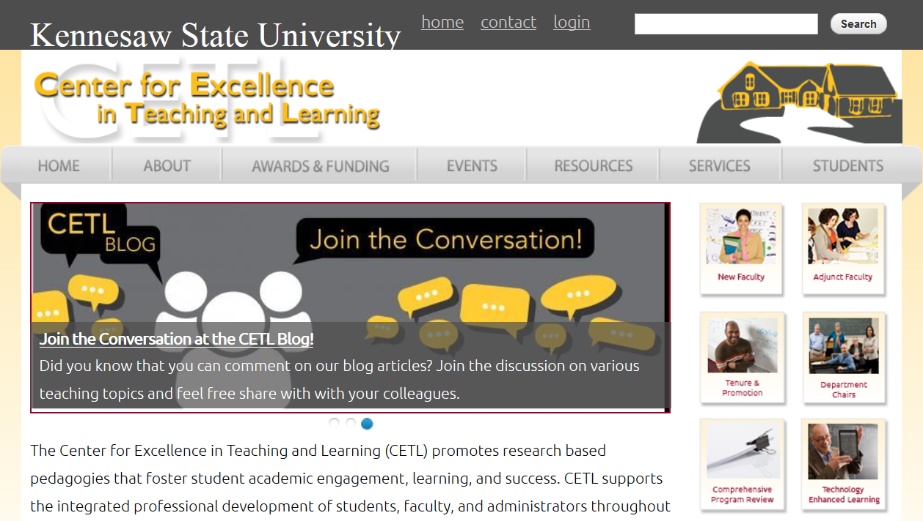
Your Constituency and their Needs
Population
Demographics and Identities
Culture of Development

Slide 7
Your Constituency and their Needs
How willing and able to participate in educational development efforts is your constituency ?

Slide 8
Your Constituency and their Needs
What resources does your unit currently have to address the particular needs of your constituency?

Slide 9
Your Constituency and their Needs
What goals does your unit have for programming that could be aided by the production and implementation of digital resources?

Slide 10
Your Constituency and their Needs Example: UNCG
Interest in surveys for on-demand resources due to competing demands for time
Goal of promoting development as normal and celebrated
Goal of reaching faculty that are not attending face-to-face programming
Working with our ITS services has given us access to a production suite

Slide 11
Your Constituency and their Needs Example: UNCG

Slide 12
Development at a Distance

Slide 13
Development at a Distance: Building Blocks
Virtual Presence
Website
Newsletter
Virtual Programming
Synchronous
Asynchronous

Slide 14
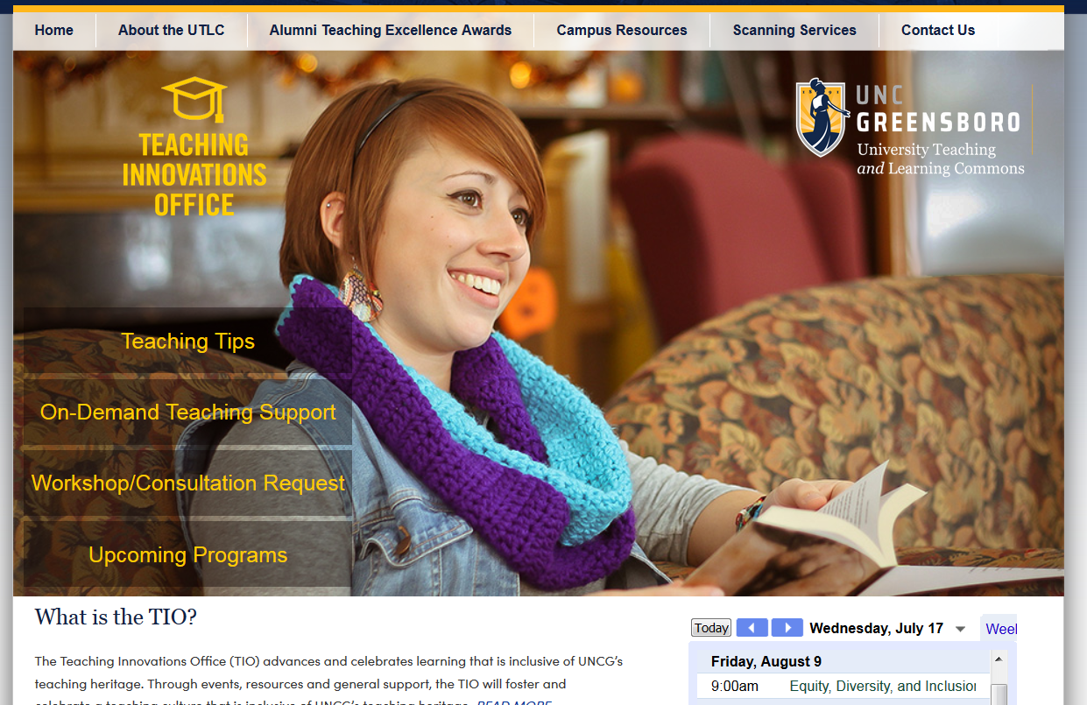
Development at a Distance: Virtual Presence of a Center
Identity
Information
Invitation

Slide 15
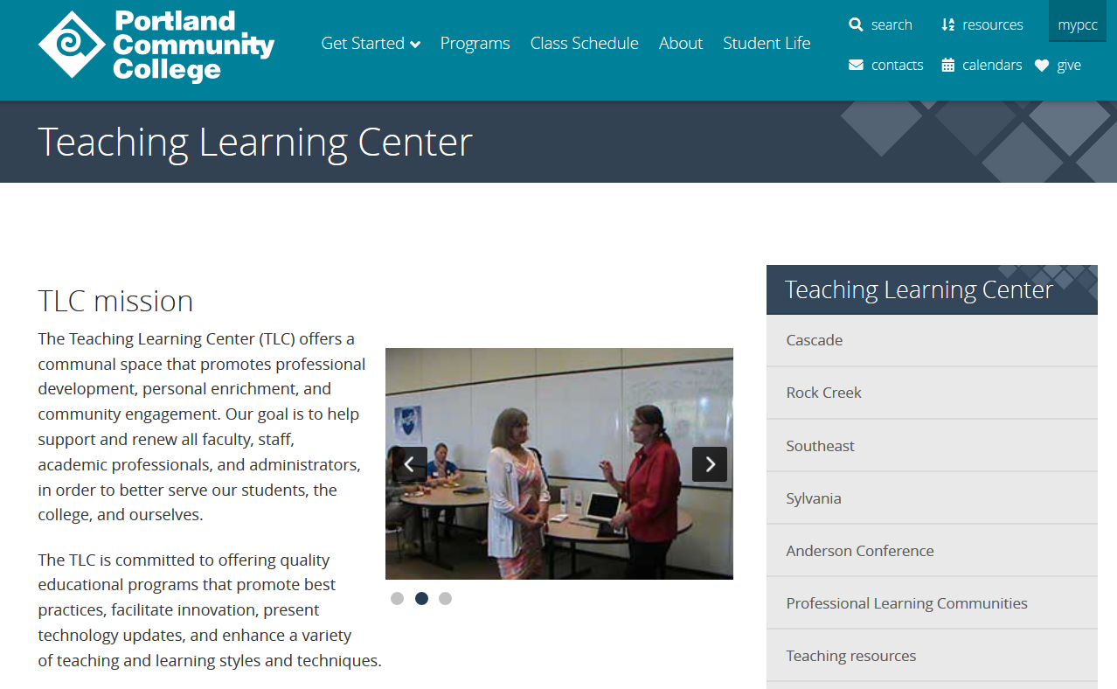
Development at a Distance: Website
Representation of mission and values
Menu of services
Collection of resources
Means of interacting

Slide 16
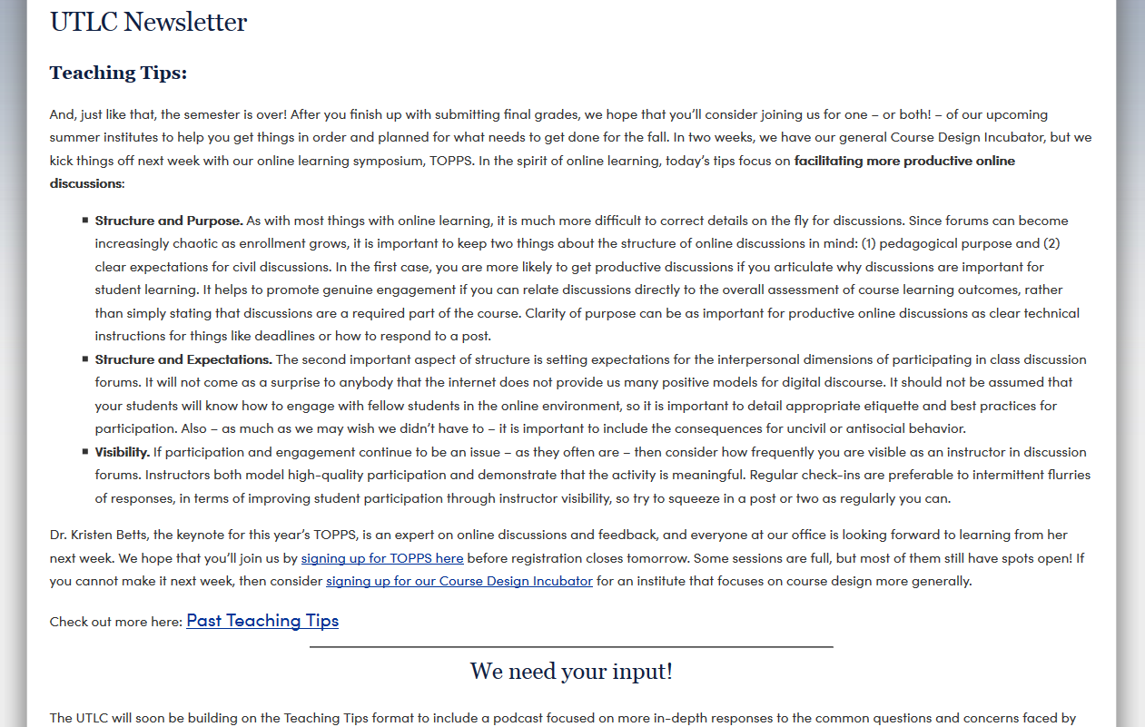
Development at a Distance: Newsletter
About programming
As programming

Slide 17
Development at a Distance: Virtual Programming
Synchronous
Asynchronous
Cohort
On-your-own

Slide 18
Development at a Distance: Synchronous Sessions
Web video conferencing
Recording synchronous sessions as on-demand resource

Slide 19
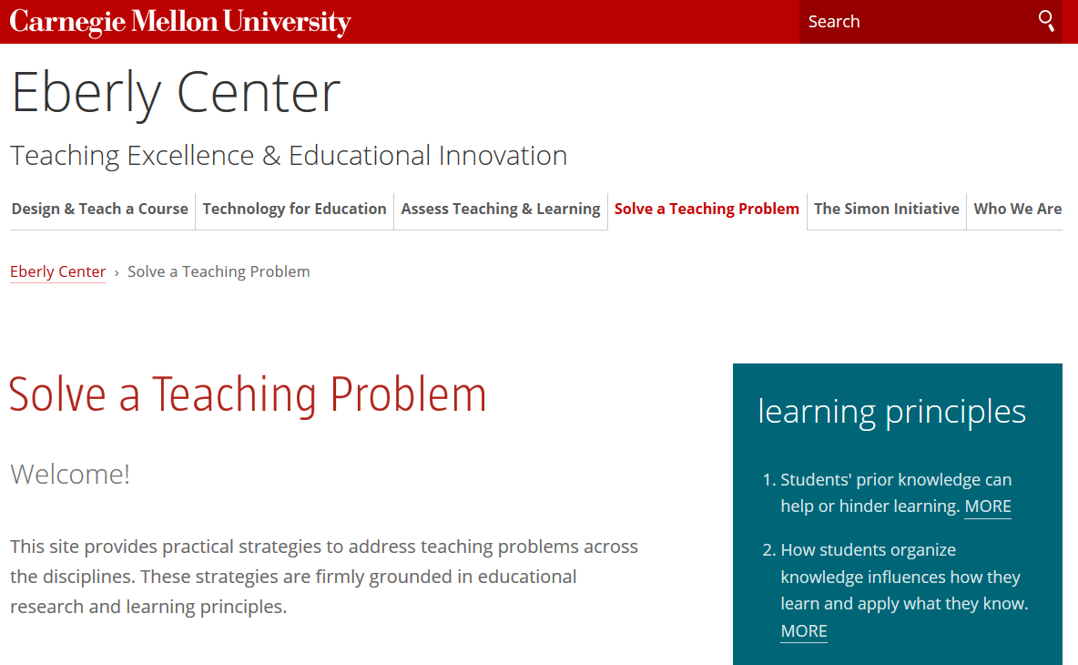
Development at a Distance: Asynchronous Options
LMS
Third-party programming
Website

Slide 20
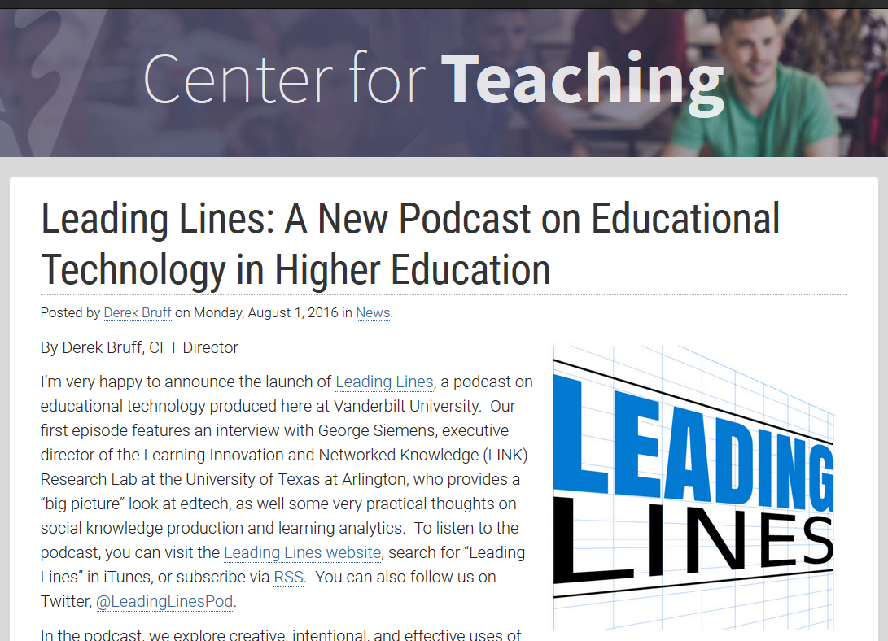
Development at a Distance: Beyond Building Blocks
More types of engaging
digital resources
Blogs/Event Recaps
Faculty Profiles/Success Stories
Podcasts/Interviews
Video Series

Slide 21
3 W’s and an H
Why, What, Who and How

Slide 22
3 W’s and an H
Why is a digital resource desirable?
What needs to be made?
Who makes it? Who delivers it (if applicable)?
How do you assess its impact?

Slide 23
Why?
Visibility
On-demand
At a distance
Resource allocation
Outsourced expertise

Slide 24
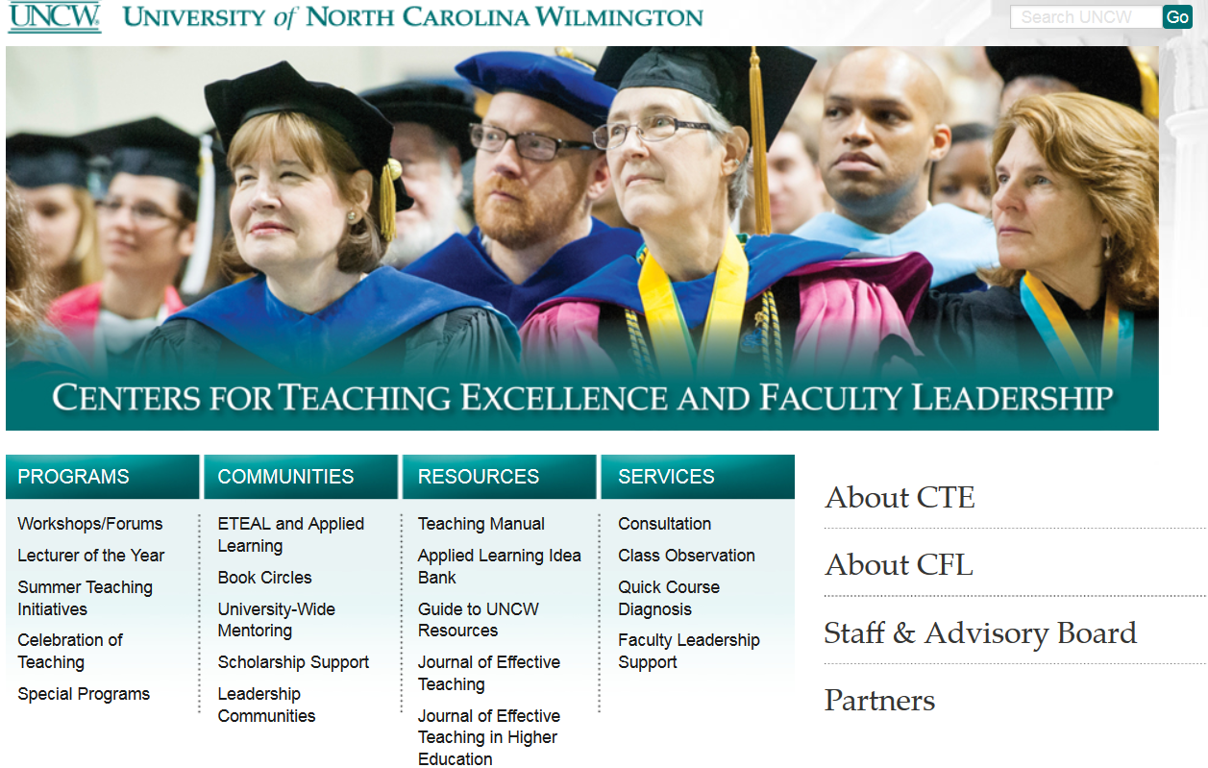
Why?
Resources
Engagement
Recognition

Slide 25
How?
Assessment for a different type of programming
Web Traffic and Pageviews
Downloads
Links to other programming
Satisfaction Surveys
Badges and Artifacts

Slide 26
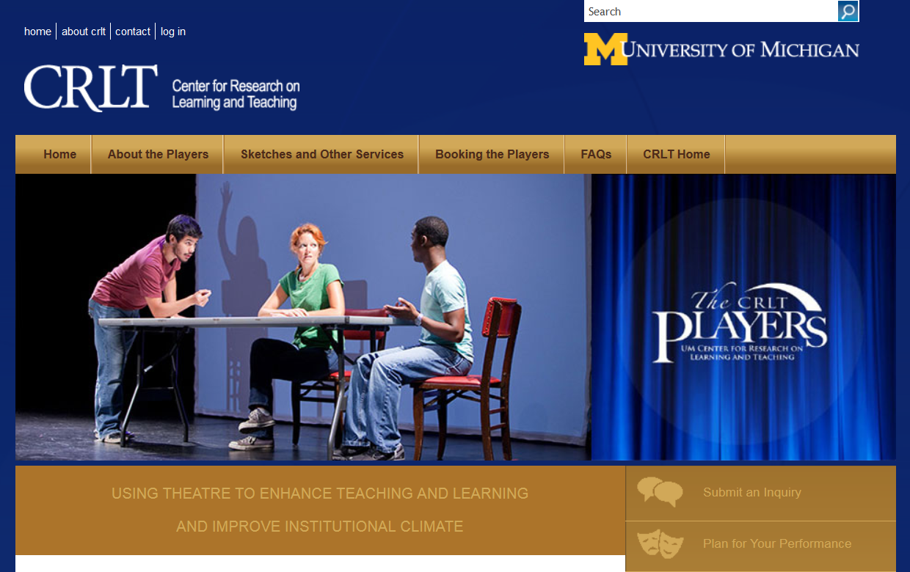
Brainstorming: Your Action Plan and Your Context
Why is a digital resource
desirable?
What needs to be made?
Who makes it?
Who delivers it (if applicable)?
How do you assess its impact?

Slide 27
Website Examples
Vanderbilt CFT – Leading Lines
CMU Eberly Center – Solve a Teaching Problem
Kennesaw State CETL – Resources by Category
Michigan CRLT – CRLT Players
Portland CC
UNCW
UNCG

Slide 28
Thank you!

