Slide 1
Active Learning
Eli Collins-Brown, Western Carolina University,
Carla Fullwood, UNCG

Slide 2
Who is here?
Turn to neighbor, share:
Name
Institution
Role
Best learning experience (engage your senses)
Feel like
Sound like
Smell like
Look like
Taste like
Notes:
Ask for a couple of their partner’s learning experiences.

Slide 3
What is Active Learning
Consider your response (30 sec)
Turn to a neighbor and share (45 sec)
Report out (60-90 sec)
Stop
Stop
End

Slide 4
Description of Active Learning
Any approach to instruction in which all students are asked to engage in the learning process. Active learning stands in contrast to "traditional" modes of instruction in which students are passive recipients of knowledge from an expert.
Active learning can take many forms and be executed in any discipline. Commonly, students will engage in small or large activities centered around writing, talking, problem solving, or reflecting.
Center for Educational Innovation, Univ of Minnesota

Slide 5
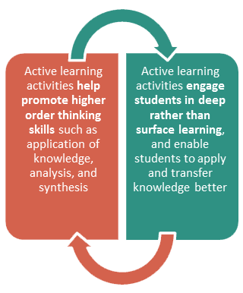
What did we just do?
From Queens University
(Kingston, Ontario, Canada)

Slide 6
Types of Active Learning Techniques
Notes:
Ask audience to call out AL techniques they know of

Slide 7
5 Simple Active Learning Techniques
Pause for Reflection
Think/Pair/Share
One Minute Paper
Self-Assessment
Large Group Discussion

Slide 8
5 Complex Active Learning Techniques
Active Review Sessions (Games or Simulations)
Role Playing or Forum Theater
Jigsaw Discussion
Inquiry Learning
Brainstorming

Slide 9
Jigsaw in action
Each group researches one technique, becomes the expert on it
Active Review Sessions (Games or Simulations)
Role Playing or Forum Theater
Jigsaw Discussion
Inquiry Learning
Experiential Learning

Slide 10
Jigsaw in action- Consider...
Description of techniques
When is technique appropriate to use?
What prep is needed by instructor?
What prep is needed by students?
Technology needs

Slide 11
Jigsaw Part Two – Putting it together
Move to your next assigned group
There should be a A, B, C, D, and E person at each table
Each person has 1 minute to share what they learned
Notes:
Description of techniques
When is it appropriate use
What prep is needed by instructor
Prep needed by students
tech/set-up needs

Slide 12
Circle Back
What will you do or use?
What did you learn?
Active Learning
as Educational Developers
What do you need?

Slide 13
Considerations
Generational Differences
meet students where they are
use of social media (construct a tweet, tweet a thought)
Contemporary case studies (local/national news)
Learning Styles/Ability
Engaging students within the spectrum, with varying emotional or cognitive needs
Accessibility (visible and invisible needs)
“Inclusive” Active Learning
Group work (ability, age, gender/gender expression, race... )
Use of technology

Slide 14
Resources
How can you incorporate active learning into your classroom? CRLT, Univ of Michigan
Active Learning Cheat Sheet CFT, Vanderbilt Univ.
Active Learning Module Queen’s University
Other ideas?

